Slide 1
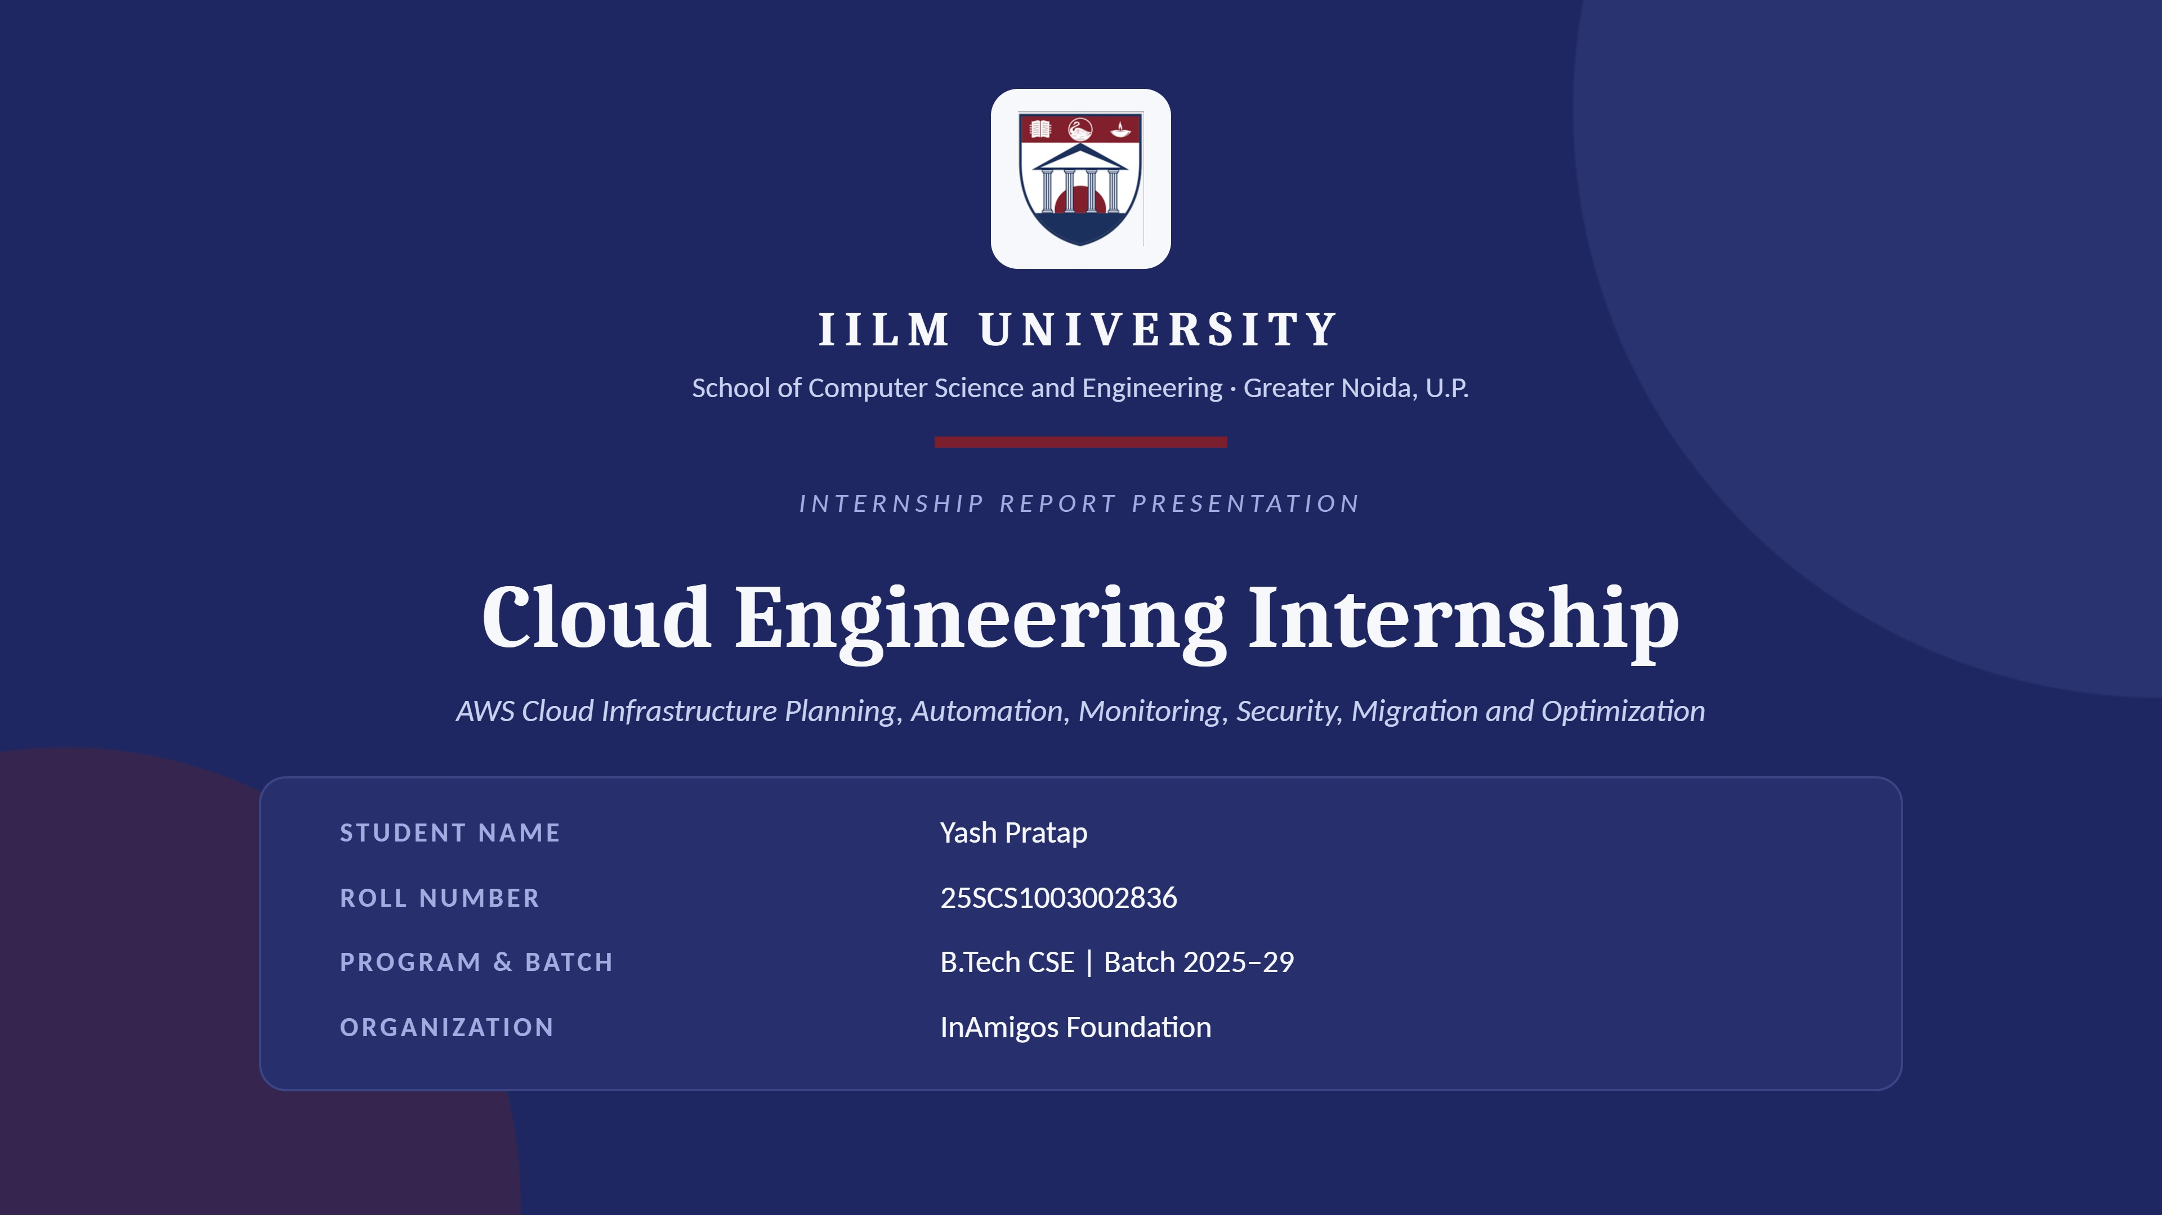
Yuva Intern

Slide 2

Presentation Outline
Introduction
06
System Architecture
Organization Profile
07
Methodology
Problem Statement
08
Task-wise Work
Objectives & Scope
09
Key Targets & Learning Outcomes
Technologies Used
10
Evidence, Certificate & References
IILM UNIVERSITY
Cloud Engineering Internship
2

Slide 3
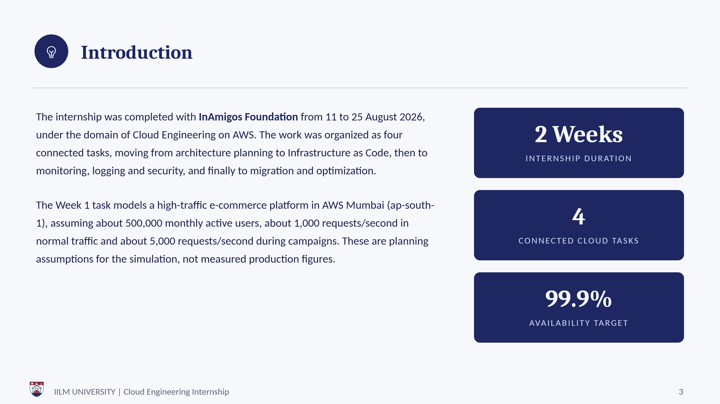
Yuva Intern

Slide 4
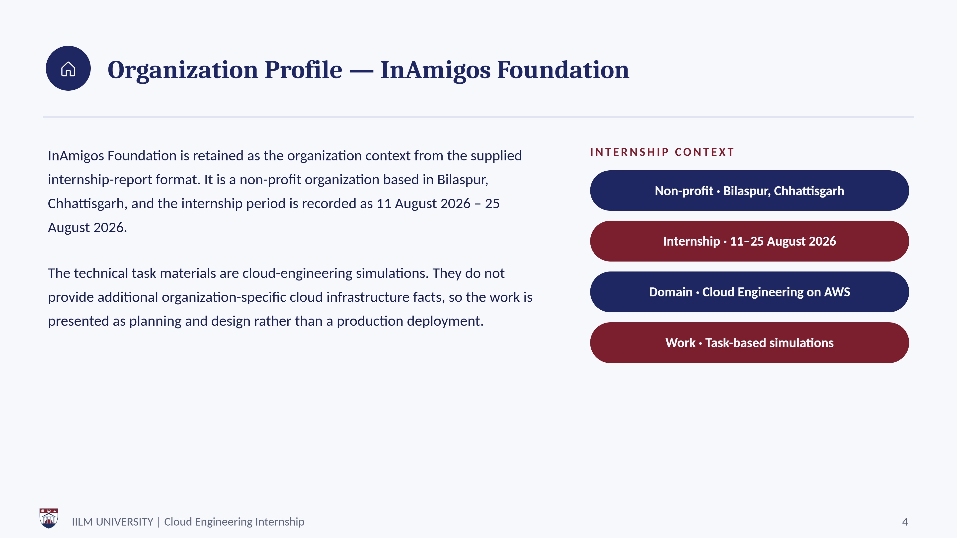
Organization Profile — Yuva Intern
Yuva Intern is the internship provider identified in the completion certificate. The internship period is recorded as 11 August 2026 – 25 August 2026.
Internship Provider · Yuva Intern

Slide 5
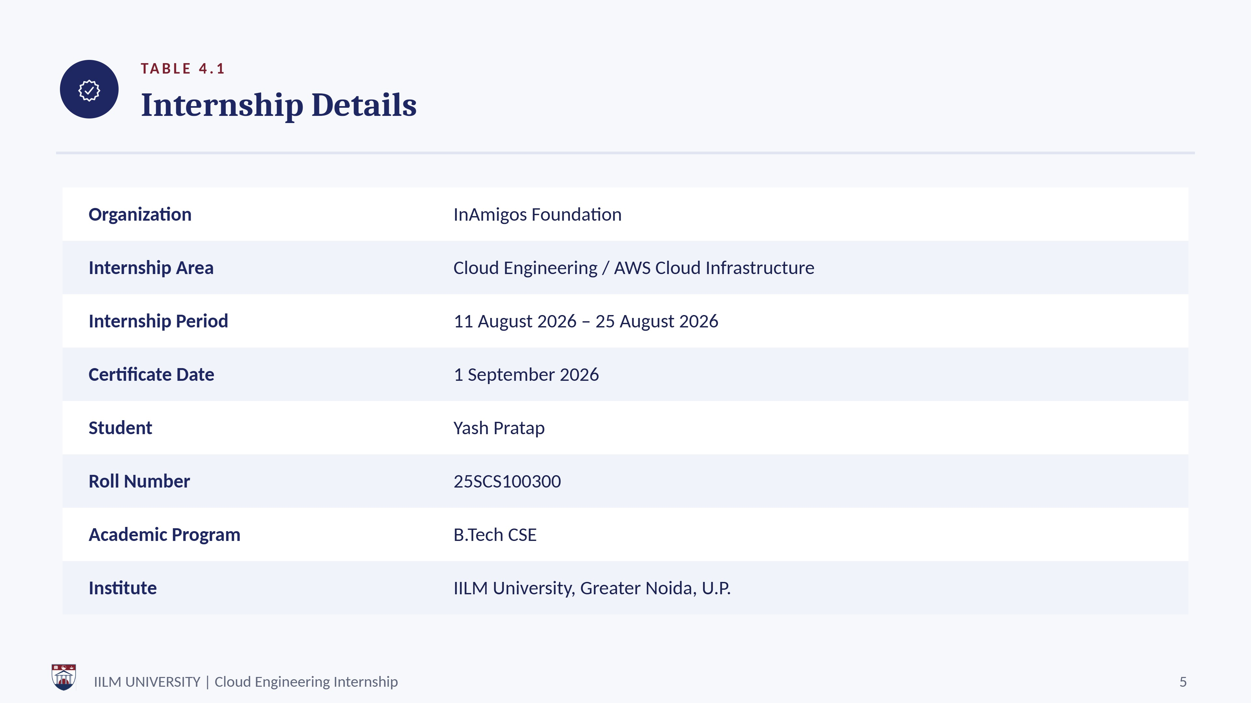
Yuva Intern

Slide 6



Problem Statement
The internship tasks address a common cloud-engineering problem: how to design, automate, observe, secure and migrate a variable-traffic application while maintaining availability and controlling operational cost.
The work follows one lifecycle across four tasks: architecture planning, automation, monitoring and security, and finally migration with performance, resilience and cost optimization.
Design G Automate
An e-commerce simulation combining horizontal scaling, caching, queue-based decoupling, health checks, backups and load testing.
Secure G Migrate
A staged move from manually managed servers, shared MySQL, local/NAS storage and limited monitoring to managed AWS services with controlled cutover.
IILM UNIVERSITY
Cloud Engineering Internship

Slide 7



Project Objectives
Understand scalable, secure and cost-aware AWS architecture planning.
Use Terraform for repeatable Infrastructure as Code.
Design network segmentation, IAM controls, load balancing, auto-scaling and managed databases.
Use CloudWatch, CloudTrail and VPC Flow Logs for observability and audit.
Understand GuardDuty and Inspector for security detection and vulnerability assessment.
Plan staged migration with replication, validation and rollback.
Evaluate performance, resilience and cost using measurable targets.
Document technical decisions with diagrams, tables, runbooks and evidence checklists.
IILM UNIVERSITY
Cloud Engineering Internship

Slide 8



Scope of the Project
IN SCO PE
0 UT 0 F SCO PE
Architecture planning and AWS service selection
Infrastructure as Code with Terraform Monitoring, logging and security controls Migration planning and optimization
A hypothetical e-commerce workload
Actual AWS deployment (not established by the task reports)
Fabricated screenshots or terminal outputs
Measured latency or actual billing data
Successful migration evidence, unless separately attached
IILM UNIVERSITY
Cloud Engineering Internship
8

Slide 9










TechnoloGgies
TA BLE 4. 3 • 1 0 F 2
Tools Used
Amazon Web Services (AWS)
Cloud infrastructure and managed services
Terraform
Infrastructure as Code and repeatable provisioning
EC2 / Auto Scaling
Stateless application compute and horizontal scaling
Application Load Balancer
Traffic distribution and health checks
RDS for MySQL
Managed relational database and failover planning
S3
Object storage, backups and artifacts
IILM UNIVERSITY
Cloud Engineering Internship

Slide 10










TechnoloGgies
TA BLE 4. 3 • 2 0 F 2
Tools Used
CloudFront / WAF / Route 53
Edge delivery, protection and DNS
ElastiCache for Redis
Caching hot reads, sessions and frequently used data
SQS
Asynchronous background processing and decoupling
CloudWatch / CloudTrail
Metrics, logs, alarms and API auditing
GuardDuty / Inspector
Threat detection and vulnerability assessment
Systems Manager / IAM / Secrets Manager
Secure administration, least privilege and secrets handling
IILM UNIVERSITY
Cloud Engineering Internship

Slide 11


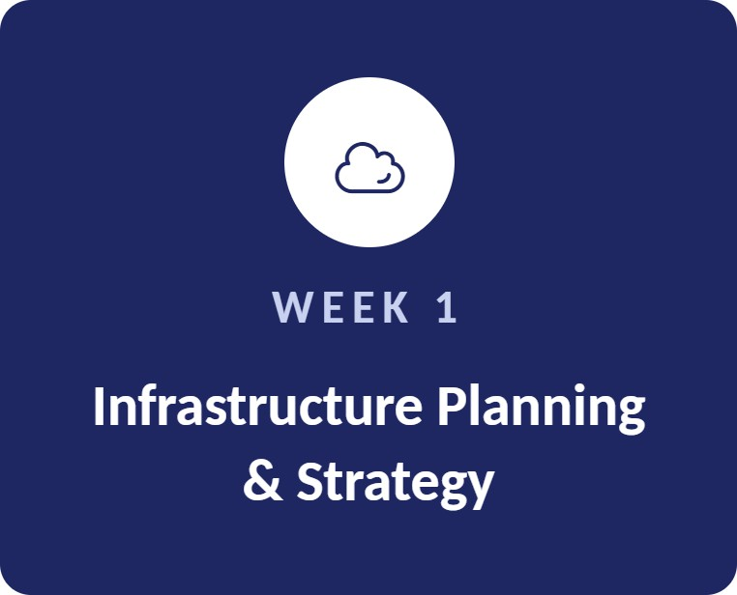
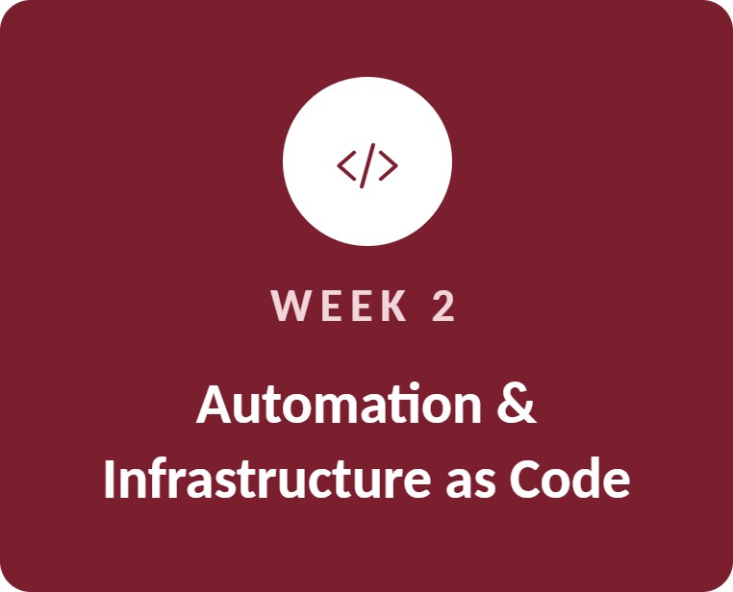
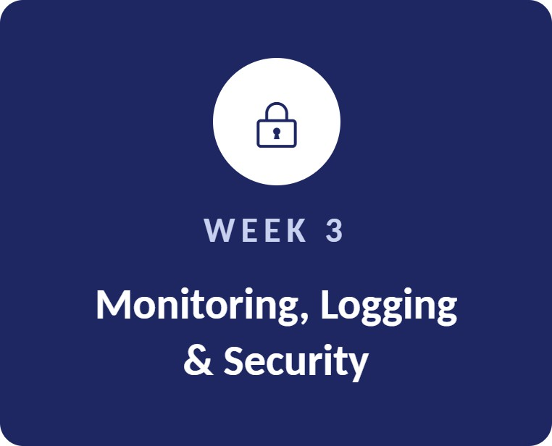
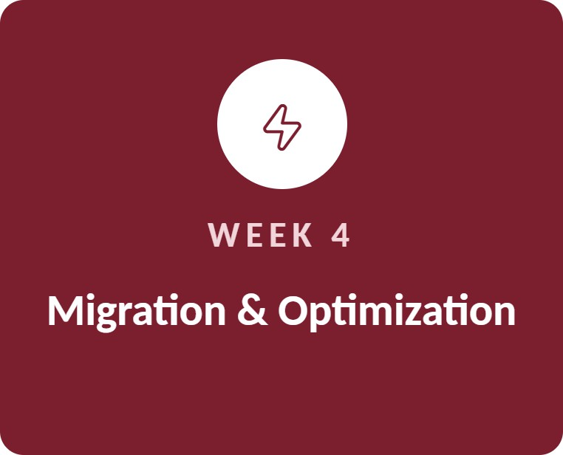
Integrated Cloud Engineering Workflow
FI G U R E 4. 1
The four tasks form one engineering li(ec cle: architecture planning, automation, monitoring and security, and hnall
and cost optimization.
migration, per(oFmance, resilience
IILM UNIVERSITY
Cloud Engineering Internship

Slide 12


Reference AWS E-Commerce Architecture
FI G U R E 4.2
U S E R S
Customers
E DG E
Route 53/ CloudFront / WAF
T RAF FIC
Application Load Balancer
C 0 M P U T E
Stateless EC2 / ECS
app tier
DATA
RDS MySQL
(Multi-AZ)
S U P P 0 RT IN G S E RV IC E S
Redis & S3
Reduce unnecessary load: caching and object storage
SQS
Decouples background work from the request path
CloudWatch & CloudTrail
Observability and audit across the stack
IILM UNIVERSITY
Cloud Engineering Internship

Slide 13





Methodology
1
Requirement Analysis
Workload assumptions, availability, security and deliverables were identified.
Architecture Planning
Managed AWS services were selected, with network, scaling and recovery controls defined.
Infrastructure as Code
Terraform formatting, validation, planning and apply workflows.
Monitoring and Security
Metrics, logs, audit trails and security findings.
5
Migration Planning
Staged waves, DMS replication, validation, cutover and rollback.
Performance and Cost Evaluation
Latency, throughput, error rate, saturation and cost are the measures to track.
6
7
Documentation and Evidence
Genuine screenshots, terminal outputs and original work are preserved.
IILM UNIVERSITY Cloud Engineering Internship

Slide 14


TABLE 4.2
Tasks at a Glance
01
02
Week 1: Cloud Infrastructure Planning & Strategy
Primary (ocus
Scalable, secure and cost-effective AWS architecture planning
Week 2: Cloud Automation & Infrastructure as Code
Primary (ocus
Terraform-based AWS infrastructure automation
03
Week 3: Monitoring, Logging & Cloud Security
Primary (ocus
CloudWatch, logging, audit and security controls
04
Week 4: Cloud Migration & Optimization
Primary (ocus
Migration, performance, resilience and cost optimization
IILM UNIVERSITY Cloud Engineering Internship

Slide 15
Task 1 Cloud Infrastructure Planning G Strategy
AS S IG N M E N T 1 • W E E K 1
Route 53, CloudFront, AWS WAF Applicafion Load Balancer
Stateless EC2 Auto Scaling or ECS across at least two Availability Zones
RDS MySQL Multi-AZ, Redis, S3 SQS
CloudWatch, CloudTrail, Secrets Manager
Established a reference architecture for a high-traffic e-commerce platform in AWS Mumbai, assuming 500,000 monthly active users, about 1,000 requests/second normally and about 5,000 during campaigns.
The design targets 99.9⁰a availability, RTO :2 ó0 minutes and RPO :2 15 minutes for critical transactional data. Scaling compute alone is not enough when the database becomes a bottleneck, so caching, connection limits, health checks, queues and load testing were included.
IILM UNIVERSITY Cloud Engineering Internship

Slide 16



Task 2 Cloud AutomaGtion
AS S IG N M E N T 2 • W E E K 2
Infrastructure as Code
Translated the architecture into a Terraform-based AWS implementation plan: a VPC across two Availability Zones, public and private subnets, ALB, EC2 Auto Scaling, RDS MySQL, S3, IAM / Systems Manager and CloudWatch.
init
fmt
validate
plan
apply
Security groups restrict application and database access by tier, and Systems Manager is used instead of opening SSH. Production improvements include HTTPS, WAF, Multi-AZ RDS and protected remote Terraform state.
2 —› 6
IN STA N CE S
AVG C P U TA RG ET
IILM UNIVERSITY Cloud Engineering Internship

Slide 17


Task 3 Monitoring, Logging G Cloud Security
AS S IG N M E N T 3 • W E E K 3
Workload health: metrics, logs and alarms
Audit evidence for AWS API acfivity Network-flow metadata for investigation
Threat detection
EC2 vulnerability assessment
Added CloudWatch Agent, CloudWatch Logs and Metrics, CloudTrail, VPC Flow Logs, GuardDuty, Inspector, IAM and Systems Manager around a sample EC2 / Nginx workload.
CloudWatch alarms watch CPU and EC2 status checks, and the Agent adds memory and disk metrics plus Nginx and system logs. Validation covers HTTP traffic, CPU stress, logs, audit events, security findings and Security Group rules.
IILM UNIVERSITY
Cloud Engineering Internship

Slide 18










Task 4 Cloud Migration G Optimization
AS S IG N M E N T 4 • W E E K 4
300 IMS
600 IItS
Planned a staged migration from a legacy on-premises e-commerce environment (manually managed application servers, shared MySQL, local/NAS storage and scheduled jobs) to AWS.
P95
P99 LAT E N C Y
LAT E N C Y
5,000+
REQU ESTS S ECON D
0.5⁰Ź0
E R RO R RAT E
DMS is recommended for full-load and ongoing change-data-capture replication. Re-platforming uses stateless instances or tasks, shared sessions, S3 objects and externalized secrets, and cutover follows a rehearsed runbook with explicit rollback triggers.
60 minutes
RECOV E RY T I ME
CDN caching, Redis, query/index tuning, queues, connection
pooling, autoscaling and compression
IILM UNIVERSITY
Cloud Engineering Internship

Slide 19
ICey Planning Targets G Controls
TA B L E 4. 4 • P LA N N IN G AS S U M PT 10 N S , N OT M EAS U R E D R ES U LTS
AREA TA RG ET / CON T RO L PU R POS E
Availability
99.9%
-1,000 / -5,000 req/s
fi 60 minutes
Multi-AZ architecture and managed services
Capacity planning assumptions Recovery runbook and failover planning
Point-in-time recovery and critical backups Post-migration target
Tail-latency target Error-rate target Load-test target
Demonstration autoscaling policy Operational alerting example
Traffic
RTO RPO
P95 latency
:2 15 minutes
fi 300 ms
ñ 600 ms
< 0.5⁰0
5,000+ req/s
2 —+ 6 instances; 60% CPU
> 70% for two 1-minute periods
P99 latency
Sxx rate
Peak throughput
Tenaformscalingdemo
CPU alarm
IILM UNIVERSITY
Cloud Engineering Internship

Slide 20





Learning Outcomes
Cloud architecture reasoning across networking, compute, data and edge services
Understanding of observability, audit trails and security findings
Understanding of private/public subnet design and least-privilege controls
Ability to plan migration with replication, validation and rollback
Familiarity with Terraform and reproducible infrastructure
Awareness that performance and cost claims require measurement
Good cloud design starts with clear assumptions and sound architecture, but per(ormance, resilience and cost claims still depend on measurement.
IILM UNIVERSITY
Cloud Engineering Internship

Slide 21
Challenges G Planned Mitigations
C H A LLE N G E S
Traffic spikes
CloudFront caching, WAF, ALB and autoscaling with load testing
Database bottlenecks
Redis, query/index tuning, connection pooling and justified read replicas
Credential compromise
IAM least privilege, MFA, Secrets Manager, key rotation and CloudTrail
Deployment failure
CI/CD, immutable releases, health checks and rehearsed rollback
Migration consistency
Continuous replication, validation and controlled final synchronization
Unexpected cost
Budgets, billing alarms, rightsizing, lifecycle policies and measured commitment decisions
IILM UNIVERSITY
Cloud Engineering Internship

Slide 22


Limitations G Future Improvements
LI M ITAT ION S
F U T U RE IM PROV E M E N TS
This report is based on supplied simulation and planning reports. It does not contain genuine AWS deployment screenshots, measured latency, actual billing data or successful migration evidence unless separately attached.
Execute Terraform in a controlled AWS account and capture genuine evidence
Add HTTPS/ACM, production WAF rules and stronger IAM controls
Use protected remote Terraform state and controlled state management
Enable and test Multi-AZ RDS failover and restore
s Integrate SIEM and formal incident-response procedures
Run repeatable 1,000/ 3,000/ 5,000 req/s load tests and record P50/P95/P99
Measure cost per successful order/request before long-term commitment decisions
This report keeps planning assumptions separate from deployment evidence: no measured AWS result has been invented.
IILM UNIVERSITY
Cloud Engineering Internship

Slide 23

Evidence G Completion Proof
C H EC K LI ST B E F 0 RE S U B M IS S ION
The task reports require genuine screenshots, terminal outputs and original work files. Each item below is attached only where the work was actually performed.
EVI DE NC E IT E M WHAT TO ATTAC H
Week 1 architecture
Week 2 Terraform Week 2 AWS resources Week 3 monitoring
Week 3 security
Week 4 migration
Week 4 testing
Internship certificate
Final architecture / planning document
terraform validate / plan / apply/ output screenshots Console evidence if actually deployed
CloudWatch metrics, logs and alarm evidence
CloudTrail, Flow Logs, GuardDuty, Inspector and SG evidence DMS replication / validation / cutover evidence if performed Load and recovery test results
Original certificate issued for Yash Pratap Required emails / submission / sharing proof
Communication proof
IILM UNIVERSITY
Cloud Engineering Internship

Slide 24
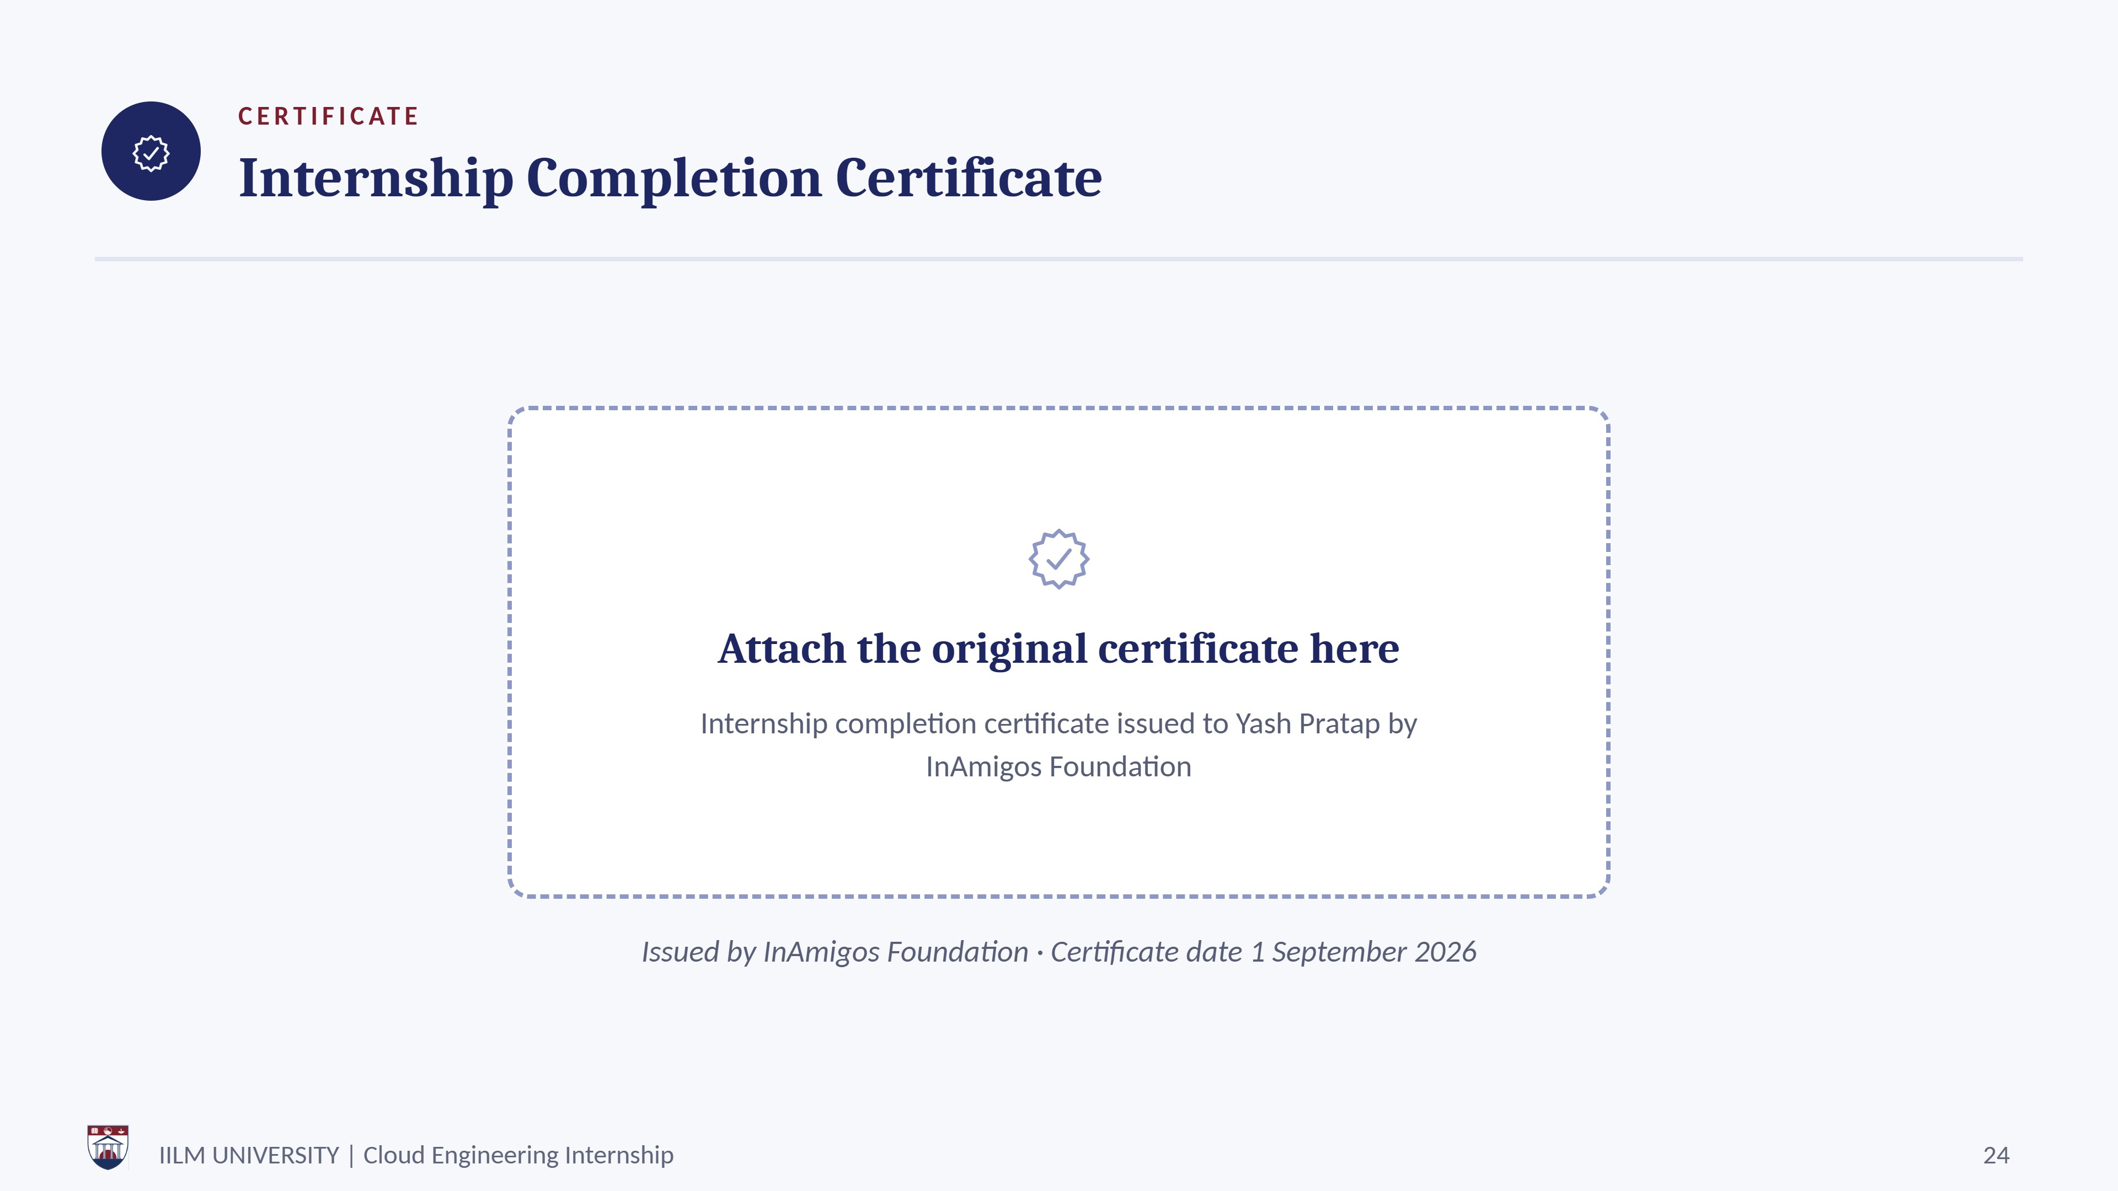
Yuva Intern
Issued by Yuva Intern · Certificate date 1 September 2026

Slide 25










References
BI B LI 0 G RA P H Y
Cloud Infrastructure Planning & Strategy Simulation, Week 1 task report, supplied internship material.
Cloud Automation and Infrastructure as Code Implementation, Week 2 task report, supplied internship material.
Monitoring, Logging, and Cloud Security Setup Simulation, Week 3 task report, supplied internship material.
Cloud Migration and Optimization Project, Week 4task report, supplied internship material.
AWS documentation: Amazon EC2, Elastic Load Balancing, Amazon RDS, Amazon S3 and Amazon CloudFront.
AWS documentation: AWS WAF, Route 53, Amazon ElastiCache, Amazon SQS and Amazon CloudWatch.
AWS documentation: AWS CloudTrail, VPC Flow Logs, Amazon GuardDuty, Amazon Inspector, IAM and Systems Manager.
AWS Database Migration Service documentation and migration guidance.
Terraform documentation for AWS provider, configuration, validation and planning workflows.
Internship Report Format / reference report supplied for structure and presentation guidance.
IILM UNIVERSITY
Cloud Engineering Internship
25

Slide 26
Thank You
Yash Pratap I25SCS100300

